Slide 1
_{Digital portfolio}
STUDENT NAME : Thowfika . J
Register no And NMID: 23f1f8054c454A0374dai48952c4b0
Department: bsc . Computer science , Ii year
College / University: Shree Raghavendra Arts and Science College,
Annamalai University.

Slide 2
Project tittle
DIGITAL PORTFOLIO :
A Digital Portfolio is a collection of an individual’s work and achievements in digital form.
It showcases skills, knowledge, experiences, and creativity.
It can include documents, images, videos, certificates, and projects .

Slide 3
Agenda
1.Problem Statement 2.Project Overview 3.End Users 4.Tool and Technologies
5.Portfolio design and Layout
6.Features and Functionality
7.Results and Screenshots
8.Conclusions
9.Github link

Slide 4
Problem Statement
Traditional resumes provide only limited information and lack interactivity. In today’s digital-first era, professionals and students need a modern, accessible, and engaging way to showcase their skills, achievements, and projects.
A digital portfolio solves this by serving as an online identity that highlights personal and professional competencies in a structured and visually appealing manner.
For example : In the context of a Digital Portfolio, the problem statement would highlight how traditional resumes are limited and why a modern, interactive portfolio website is required.

Slide 5
Project Overview
Project Tittle : Digital Portfolio Website
*The project focuses on designing and developing a personal digital portfolio website for presenting academic details, technical skills, projects, and achievements. It is built with a responsive, user-friendly interface to ensure accessibility across devices and enhance professional visibility.
Features:
1.User-Friendly Interface - Simple and easy-to-navigate design. 2.Responsive Layout - Accessible on mobile, tablet, and desktop devices.

Slide 6
End users
1.Recruiters/Employees : To evaluate candidate profiles.
2.Faculty/Examiners : For project and academic assessments
3.peers/Collaborator : For exploring work and collaboration.
4.General Audience : For networking and professional connections.

Slide 7
Tools and Technologies
1.Tools:
*Editor/Platform - Visual Studio Code
*Design Tools - Figma, Canva *Version Control & Hosting - Git , GitHub, Netlify, Vercel
2.Technologies:
*Frontend : HTML5, CSS3, JavaScript *Frameworks/Libraries : Bootstrap / Tailwind CSS *Integration : EmailJS / Formspree for contact form

Slide 8
PORTFOLIO design and Layout
Design:
Minimal and professional theme
Consistent typography and color scheme
Mobile-first responsive approach
Layout:
Header / Navigation Bar Logo & section link Home Section Introduction and tagline About Section Background and education Skills Section Technical and soft skills

Slide 9
Features and functionality
Features:
Resume download option Smooth scrolling navigation Project showcase with descriptions and images Contact form for direct communication
2.Functionality:
Responsive layout (desktop, tablet, mobile) Interactive hover effects and animations Social media and GitHub integration Dynamic linking to live projects and repositories

Slide 10
Results
Successfully created and deployed a digital portfolio website.
Improved professional visibility and online presence.
Showcased academic achievements and projects effectively.
Positive feedback from peers, mentors, and faculty.

Slide 11
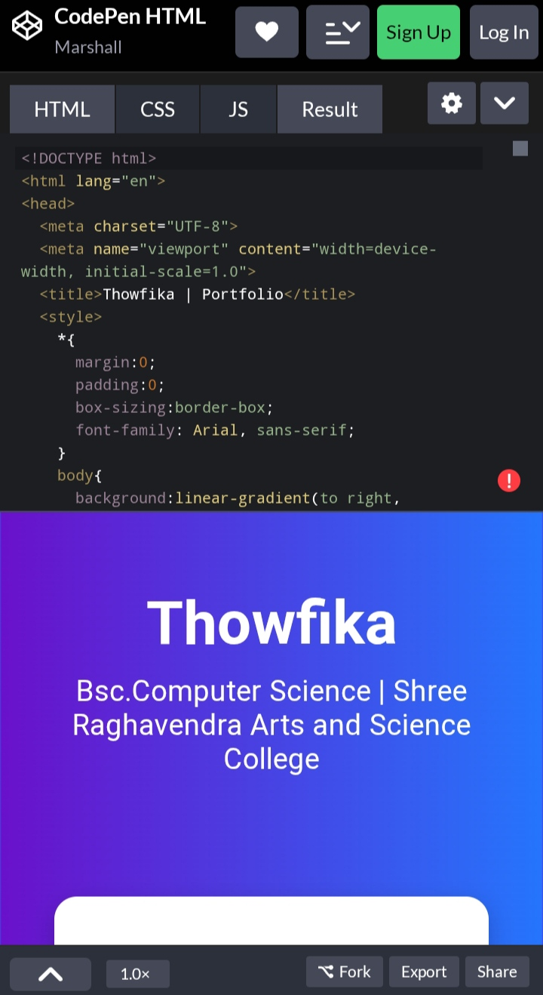
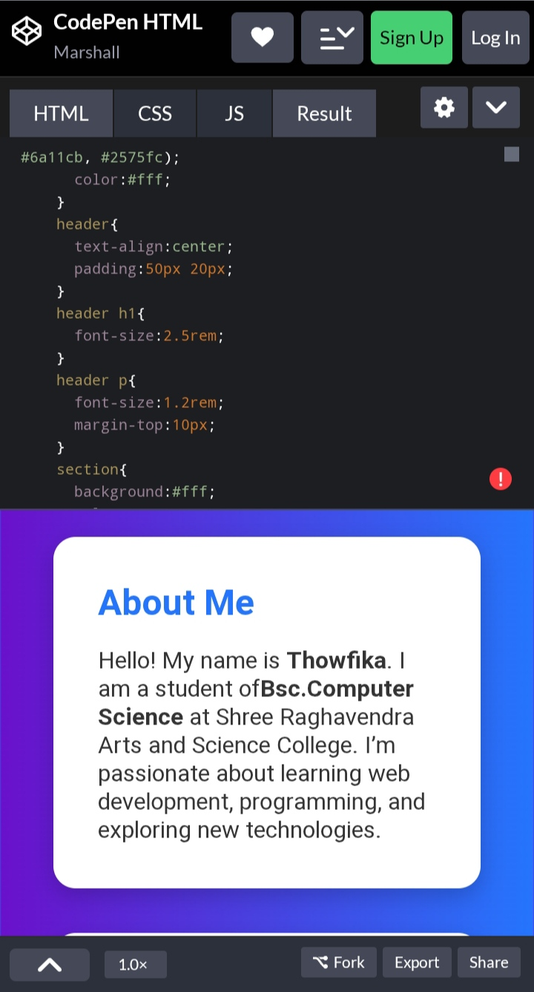
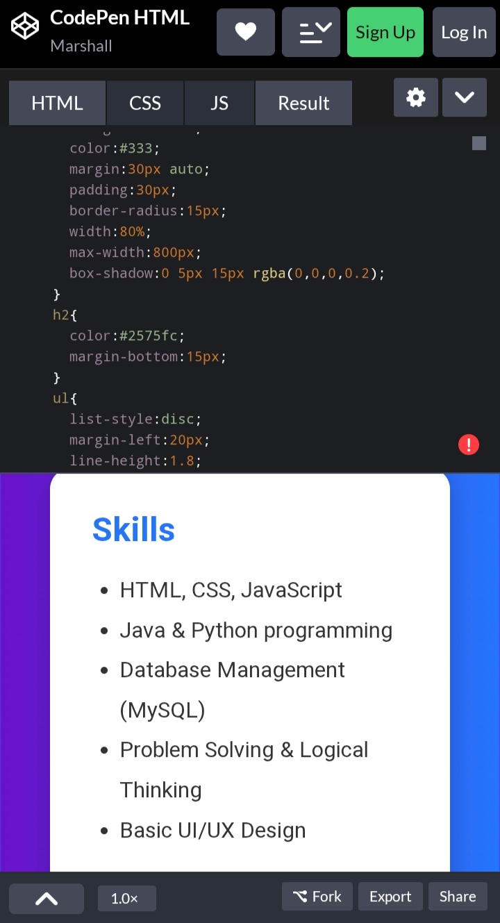
Screenshots

Slide 12
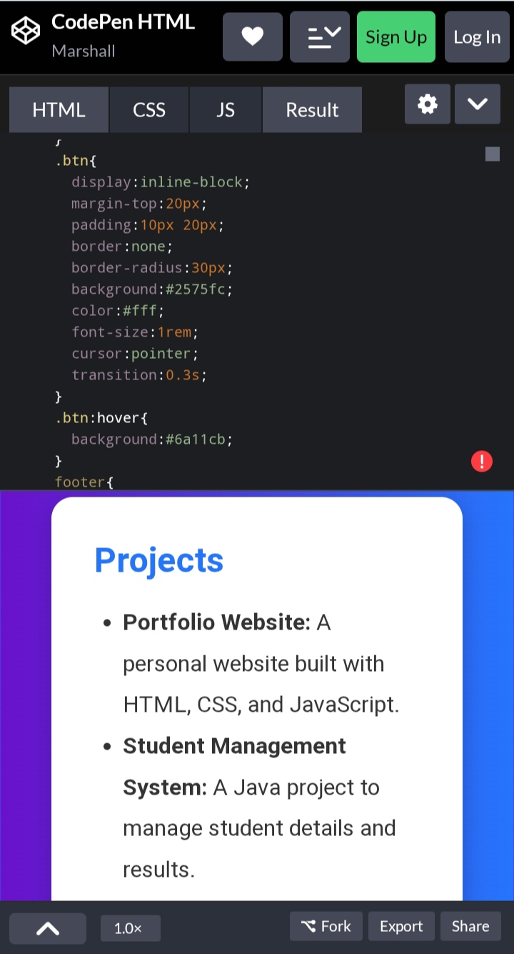
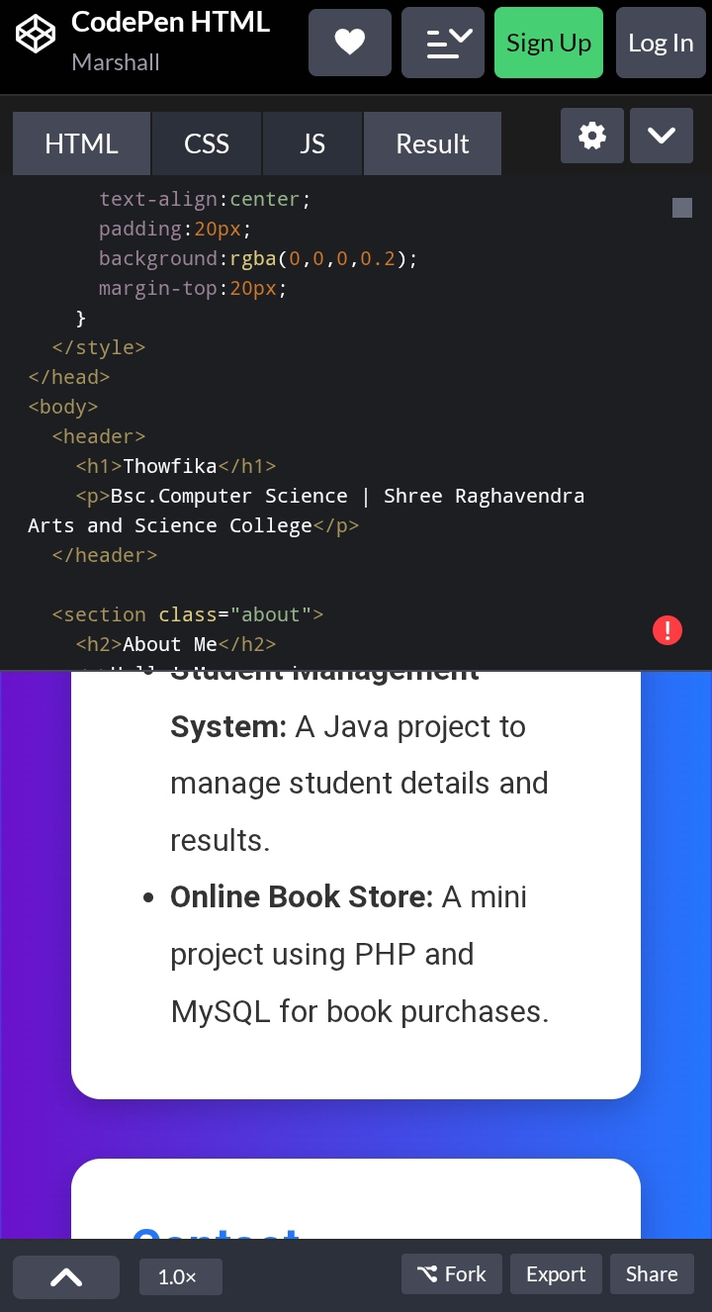
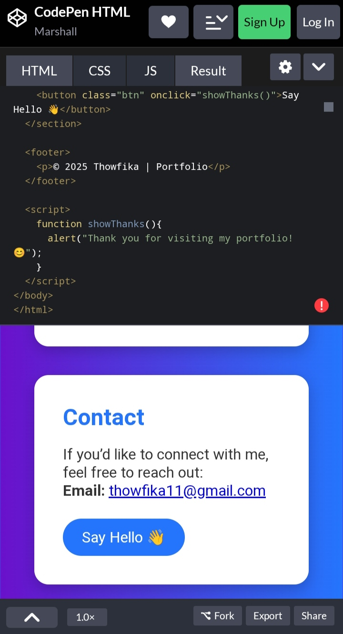
Screenshots

Slide 13
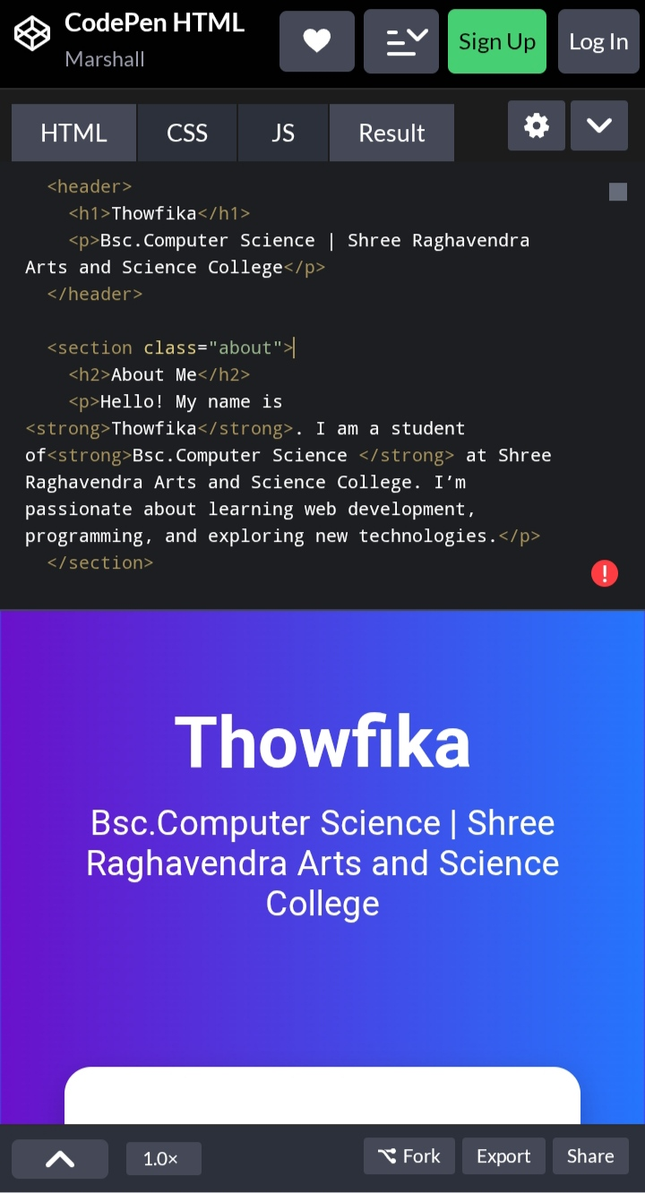
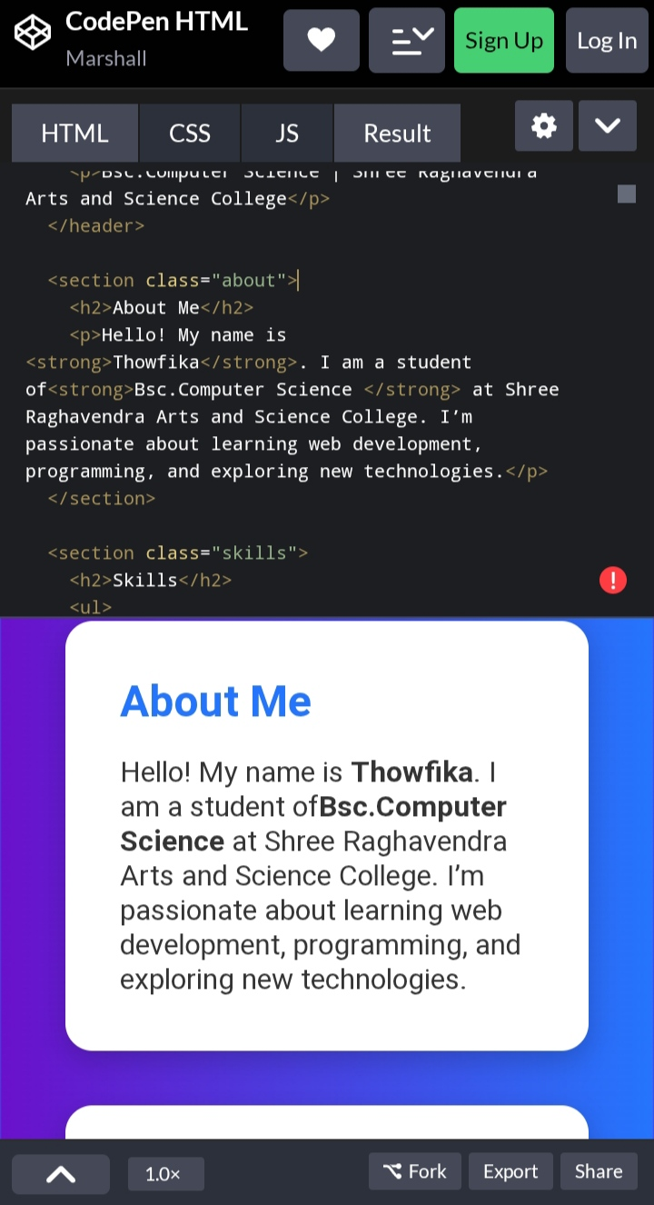
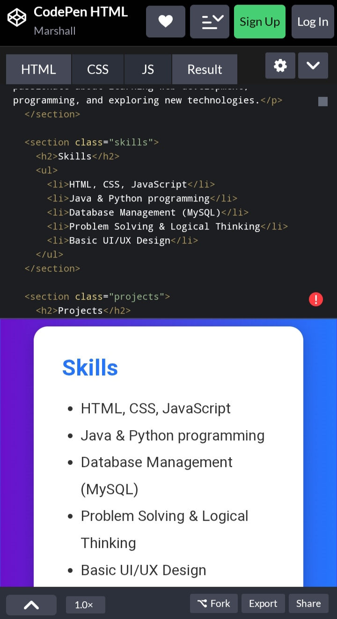

Screenshots

Slide 14
Conclusion for digital portfolio
A digital portfolio highlights skills, achievements, and creativity.
It provides a professional platform for self-presentation.
Acts as evidence of technical knowledge and project experience.
Enhances career opportunities and academic growth.Serves as a well-organized record of accomplishments.
Reflects the ability to use digital tools effectively.
.
THANK YOU...

